Slide 1
CHAPTER THREE
THEORY OF CONSUMER BEHAVIOR

Slide 2
Consumer preferences and Choices
How we were to measure utility.
How are we supposed to quantify the "amount" of utility associated with different
choices?
Is one person's utility the same as another's?
What would it mean to say that an extra candy bar would give me twice as much utility as an extra carrot?

Slide 3
Consumer preferences and Choices
Because of these conceptual problems, economists have discarded the old fashioned view of utility as being a measure of happiness.
Instead, the theory of consumer behavior has been reformulated entirely case of consumer preferences, and utility is seen only as a way to describe preferences

Slide 4
Assumptions (axioms) about Preferences
One way to begin an analysis of individuals’ choices is to state a basic set of postulates, that characterize “rational” behavior.
These begin with the concept of “preference”:
An individual who reports that “A is preferred to B” is taken to mean that all things considered, he or she feels better off under situation A than under situation B.

Slide 5
Assumptions (axioms) about Preferences
The preference relation is assumed to have four basic properties as follows:
 Completeness
if A and B are any two situations, an individual can always specify exactly one of these possibilities:
 A is preferred to B
B is preferred to A
“I am indifferent between A and B”, i.e., “I like equally A and B”.

Slide 6
Assumptions (axioms) about Preferences
Transitivity
 if A is preferred to B, and B is preferred to C, then A is preferred to C.
assumes that the individual’s choices are internally consistent.
Continuity
if A is preferred to B, then situations suitably “close to A” must also be preferred to B.

Slide 7
Assumptions (axioms) about Preferences
The purpose of the assumption is to rule out certain kinds of discontinuous that pose problems for a mathematical development of the theory of choice.
All goods are “good” (i.e. desirable)
First we will typically assume that more is better, that is, we are talking about goods, not bads.

Slide 8
Utility
  The purpose of utility analysis = analyzing how people behave rather than how they think
  Theory of consumer choice = each consumer spends his or her income in a way that yields the greatest satisfaction
  Utility = amount of satisfaction
  The more the need of a commodity or the stronger the desire to have it, the greater is the utility derived from the commodity.

Slide 9
The following are the properties of utility
Utility = want-satisfying power of a good/service
Utility ≠ Usefulness
Utility is subjective
Different individuals can get different levels of utility from the same commodity.
For example, some one who likes chocolates will get much higher utility from a chocolate than some one who is not so loving of chocolates

Slide 10
The properties of utility
Also, utility that one individual gets from the commodity can change with change in place and time.
For example, utility from the use of a room heater will depend upon whether it is summer or winter (time).

Slide 11
Approaches to Measure Utility
This chapter presents two different Measures Utility
(i) Cardinal Utility Analysis
(ii) Ordinal Utility Analysis.
Assumption of Cardinal Utility theory
Rationality of Consumers
Consumers are assumed to be rational to maximize satisfaction from consumption of goods and services

Slide 12
Assumptions of Cardinal Utility theory
Limited Money Income
The consumer has limited money income to spend on the goods and services he/she chooses to consume.
Constant Marginal Utility of Money
Marginal utility of money is constant.

Slide 13
Assumptions of Cardinal Utility theory
In this case one birr always have utility equal to satisfaction we get from owning one birr and it is equal to 1 util.
Utility is Cardinally Measurable
According to this approach, the utility or satisfaction of each commodity is measurable.
Money is the most convenient measurement of utility.

Slide 14
Assumptions of Cardinal Utility theory
Neo classical economists argued that utility is quantify (Utils)
A util is a cardinal number like 1,2,3 etc.
Diminishing Marginal Utility (DMU).
The utility derived from consumption of each successive units of a commodity diminishes in a given period of time.

Slide 15
Total Utility Versus Marginal Utility
  Total utility = total benefit to a consumer from all the units of a good purchased.
  Marginal utility = extra benefit from the last unit of a good purchased.
  Also, the change in total utility from the purchase of 1 more unit of the good.
  ↑ number of goods purchased ⇒ ↑ total utility but a ↓ marginal utility.

Slide 16

Total and Marginal Utility
Bananas
consumed
per meal
Total
Utility,
Utils
Marginal
Utility,
Utils
30
20
10
0
1
0
10
Total Utility (utils)
0 1 2 3 4 5 6 7
Units consumed per meal
10
8
6
4
2
0
-2
Marginal Utility (utils)
1 2 3 4 5 6 7
Units consumed per meal

Slide 17
Total and Marginal Utility
Banana
consumed
per meal
Total
Utility,
Utils
Marginal
Utility,
Utils
30
20
10
0
1
0
10
Total Utility (utils)
10
0 1 2 3 4 5 6 7
Units consumed per meal
10
8
6
4
2
0
-2
Marginal Utility (utils)
1 2 3 4 5 6 7
Units consumed per meal

Slide 18
Total and Marginal Utility
Bananas
consumed
per meal
Total
Utility,
Utils
Marginal
Utility,
Utils
30
20
10
0
1
2
0
10
18
Total Utility (utils)
10
8
0 1 2 3 4 5 6 7
Units consumed per meal
10
8
6
4
2
0
-2
Marginal Utility (utils)
1 2 3 4 5 6 7
Units consumed per meal

Slide 19
Total and Marginal Utility
Bananas
consumed
per meal
Total
Utility,
Utils
Marginal
Utility,
Utils
30
20
10
0
1
2
3
0
10
18
24
Total Utility (utils)
10
8
6
0 1 2 3 4 5 6 7
Units consumed per meal
10
8
6
4
2
0
-2
Marginal Utility (utils)
1 2 3 4 5 6 7
Units consumed per meal

Slide 20
Total and Marginal Utility
Bananas
consumed
per meal
Total
Utility,
Utils
Marginal
Utility,
Utils
30
20
10
0
1
2
3
4
0
10
18
24
28
Total Utility (utils)
10
8
6
4
0 1 2 3 4 5 6 7
Units consumed per meal
10
8
6
4
2
0
-2
Marginal Utility (utils)
1 2 3 4 5 6 7
Units consumed per meal

Slide 21
Total and Marginal Utility
Bananas
consumed
per meal
Total
Utility,
Utils
Marginal
Utility,
Utils
30
20
10
0
1
2
3
4
5
0
10
18
24
28
30
Total Utility (utils)
10
8
6
4
2
0 1 2 3 4 5 6 7
Units consumed per meal
10
8
6
4
2
0
-2
Marginal Utility (utils)
1 2 3 4 5 6 7
Units consumed per meal

Slide 22
Total and Marginal Utility
Bananas
consumed
per meal
Total
Utility,
Utils
Marginal
Utility,
Utils
30
20
10
0
1
2
3
4
5
6
0
10
18
24
28
30
30
Total Utility (utils)
10
8
6
4
2
0
0 1 2 3 4 5 6 7
Units consumed per meal
10
8
6
4
2
0
-2
Marginal Utility (utils)
1 2 3 4 5 6 7
Units consumed per meal

Slide 23
Total and Marginal Utility
TU
Bananas
consumed
per meal
Total
Utility,
Utils
Marginal
Utility,
Utils
30
20
10
0
1
2
3
4
5
6
7
0
10
18
24
28
30
30
28
Total Utility (utils)
10
8
6
4
2
0
-2
0 1 2 3 4 5 6 7
Units consumed per meal
10
8
6
4
2
0
-2
Marginal Utility (utils)
MU
1 2 3 4 5 6 7
Units consumed per meal

Slide 24

Total and Marginal Utility
TU
Bananas
consumed
per meal
Total
Utility,
Utils
Marginal
Utility,
Utils
30
20
10
Observe
Diminishing
Marginal
Utility
0
1
2
3
4
5
6
7
0
10
18
24
28
30
30
28
Total Utility (utils)
10
8
6
4
2
0
-2
0 1 2 3 4 5 6 7
Units consumed per meal
10
8
6
4
2
0
-2
Marginal Utility (utils)
MU
1 2 3 4 5 6 7
Units consumed per meal

Slide 25
Total and Marginal Utility
From the above table, we can conclude the following relationship between TU and MU
TU is always positive but MU maybe positive, negative and zero.
When MU is positive, TU increase at diminishing rate.
When MU is zero, TU is maximum.
When MU is negative, TU is declining.

Slide 26
Using Marginal Utility
Equilibrium of a consumer(The Optimal Purchase Rule)
  Buy the quantity of each good at which price and marginal utility are exactly equal.
  If MUx = Px the consumer is at equilibrium.
  Thus in one commodity case equilibrium is where MUx =MUm
  Px
  If marginal utility is greater (less) than price, the consumer can improve well being by purchasing more (less).

Slide 27
Equilibrium of a consumer
Two Commodities Case; Orange (X) and Banana (Y)
The consumer would be in equilibrium or utility is maximized if and only if
1.If the consumer has enough money income or
2) Allocate more money to the consumption of the good with higher utility until all the money is spent.
M Ux = MUy = MUm=1
Px Px

Slide 28
UTILITY MAXIMIZING COMBINATION
Product A:
Price = $1
Product B:
Price = $2
$ 10 income
Marginal
utility per
dollar
(MU/price)
Marginal
utility per
dollar
(MU/price)
Marginal
utility,
utils
Marginal
utility,
utils
Unit of
product
First 10 10 24 12
Examine the two
marginal utilities

Slide 29
UTILITY MAXIMIZING COMBINATION
Product A:
Price = $1
Product B:
Price = $2
$ 10 income
Marginal
utility per
dollar
(MU/price)
Marginal
utility per
dollar
(MU/price)
Marginal
utility,
utils
Marginal
utility,
utils
Unit of
product
First 10 10 24 12
Examine the two
marginal utilities
…per dollar

Slide 30

UTILITY MAXIMIZING COMBINATION
Product A:
Price = $1
Product B:
Price = $2
$ 10 income
Marginal
utility per
dollar
(MU/price)
Marginal
utility per
dollar
(MU/price)
Marginal
utility,
utils
Marginal
utility,
utils
Unit of
product
First 10 10 24 12
Decision: Buy 1
Product B for $2

Slide 31
UTILITY MAXIMIZING COMBINATION
Product A:
Price = $1
Product B:
Price = $2
$ 10 income
Marginal
utility per
dollar
(MU/price)
Marginal
utility per
dollar
(MU/price)
Marginal
utility,
utils
Marginal
utility,
utils
Unit of
product
First 10 10 24 12
Second 8 8 20 10
Third 7 7 18 9
Fourth 6 6 16 8
Fifth 5 5 12 6
Sixth 4 4 6 3
Seventh 3 3 4 2

Slide 32
UTILITY MAXIMIZING COMBINATION
Product A:
Price = $1
Product B:
Price = $2
$ 10 income
Marginal
utility per
dollar
(MU/price)
Marginal
utility per
dollar
(MU/price)
Marginal
utility,
utils
Marginal
utility,
utils
Unit of
product
First 10 10 24 12
Second 8 8 20 10
Third 7 7 18 9
Fourth 6 6 16 8
Fifth 5 5 12 6
Sixth 4 4 6 3
Seventh 3 3 4 2

Slide 33
UTILITY MAXIMIZING COMBINATION
Product A:
Price = $1
Product B:
Price = $2
$ 10 income
Marginal
utility per
dollar
(MU/price)
Marginal
utility per
dollar
(MU/price)
Marginal
utility,
utils
Marginal
utility,
utils
Unit of
product
First 10 10 24 12
Second 8 8 20 10
Third 7 7 18 9
Fourth 6 6 16 8
Fifth 5 5 12 6
Sixth 4 4 6 3
Seventh 3 3 4 2

Slide 34
UTILITY MAXIMIZING COMBINATION
Product A:
Price = $1
Product B:
Price = $2
$ 10 income
Marginal
utility per
dollar
(MU/price)
Marginal
utility per
dollar
(MU/price)
Marginal
utility,
utils
Marginal
utility,
utils
Unit of
product
First 10 10 24 12
Second 8 8 20 10
Third 7 7 18 9
Fourth 6 6 16 8
Fifth 5 5 12 6
Sixth 4 4 6 3
Seventh 3 3 4 2

Slide 35
UTILITY MAXIMIZING COMBINATION
Product A:
Price = $1
Product B:
Price = $2
$ 10 income
Marginal
utility per
dollar
(MU/price)
Marginal
utility per
dollar
(MU/price)
Marginal
utility,
utils
Marginal
utility,
utils
Unit of
product
First 10 10 24 12
Second 8 8 20 10
Third 7 7 18 9
Fourth 6 6 16 8
Fifth 5 5 12 6
Sixth 4 4 6 3
Seventh 3 3 4 2

Slide 36
UTILITY MAXIMIZING COMBINATION
Product A:
Price = $1
Product B:
Price = $2
$ 10 income
Marginal
utility per
dollar
(MU/price)
Marginal
utility per
dollar
(MU/price)
Marginal
utility,
utils
Marginal
utility,
utils
Unit of
product
First 10 10 24 12
Second 8 8 20 10
Third 7 7 18 9
Fourth 6 6 16 8
Fifth 5 5 12 6
Sixth 4 4 6 3
Seventh 3 3 4 2
$3 left...
Buy both!

Slide 37
UTILITY MAXIMIZING COMBINATION
Product A:
Price = $1
Product B:
Price = $2
$ 10 income
Marginal
utility per
dollar
(MU/price)
Marginal
utility per
dollar
(MU/price)
Marginal
utility,
utils
Marginal
utility,
utils
Unit of
product
First 10 10 24 12
Second 8 8 20 10
Third 7 7 18 9
Fourth 6 6 16 8
Fifth 5 5 12 6
Sixth 4 4 6 3
Seventh 3 3 4 2
Income is gone...
the last dollar spent on
each good gave the same
utility (8) per dollar

Slide 38
UTILITY MAXIMIZING COMBINATION
Algebraic Restatement of the
Utility Maximization Rule
MU of product A
MU of product B
=
Price of A
Price of B
8 Utils
16 Utils
=
$1
$2

Slide 39
The Ordinal Utility Theory
In other words, the consumer does not measure utility in numbers .
It is practically possible for the consumers to rank commodities in the order of their preference as 1st 2nd 3rd and so on
This forms the starting point of this topic – Ordinal Utility Analysis.

Slide 40
Assumptions of Ordinal Utility approach
The Consumers are rational.
Utility is ordinal(ranking), i.e. utility is not absolutely (cardinally) measurable
Recent theory
It is psychological
Preferences are transitive or consistent
Diminishing Marginal Rate of Substitution (MRS)
The total utility of the consumer depends on the quantities of the commodities consumed, i.e., U=f (X, Y, Z, …..)

Slide 41
Assumptions of Ordinal Utility approach
The ordinal utility approach is explained with the help of indifference curves.
Since it uses indifference curves to study the consumer’s behavior, the ordinal utility theory is also known as the Indifference Curve Analysis.

Slide 42
Indifference Set/ Schedule:
It is a combination of goods for which the consumer is indifferent, preferring none of any others.
It shows the various combinations of goods from which the consumer derives the same level of utility.
Bundle(Combination) | A | B | C | D | E
cloth (X) | 1 | 6 | 4 | 3 | 0
Food (Y) | 12 | 2 | 3 | 4 | 6

Slide 43
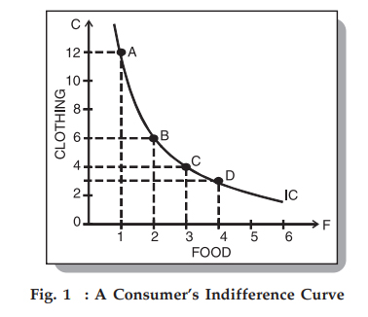
Indifference Curve
An indifference curve is a graph that shows the various combinations of two goods that provide the consumer the same level of utility or satisfaction

Slide 44
Properties of Indifference Curves:
Indifference curves slope downward to the right.
If it sloped upward it would violate the assumption that more of any commodity is preferred to less.
Any market basket lying above and to the right of an indifference curve is preferred to any market basket that lies on the indifference curve.
Indifference curves is thin (exist every were)

Slide 45
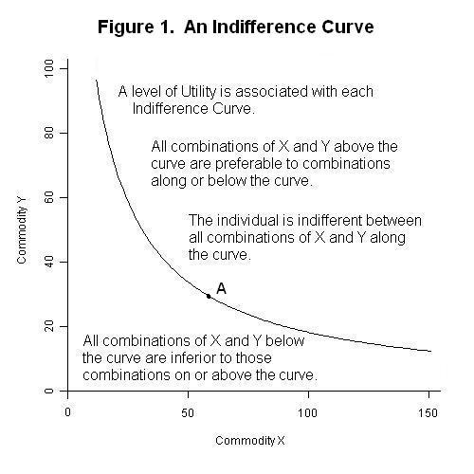
Properties of Indifference Curves:

Slide 46
Properties of Indifference Curves:
Indifference curves do not intersect each other.
Intersection between two indifference curves is inconsistent with the reflection of indifference curves

Slide 47
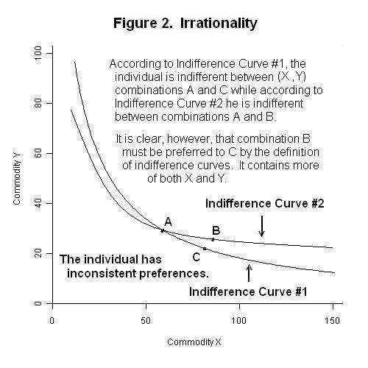

Slide 48
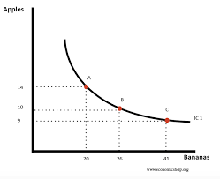
Properties of Indifference Curves
Indifference curves are convex to the origin.
This implies that the slope of an indifference curve decreases (in absolute terms) as we move along the curve from the left downwards to the right.

Slide 49
Properties of Indifference Curves
Indifference curves must get flatter as moved down along it
This assumption implies that the commodities can substitute one another at any point on an indifference curve, but are not perfect substitutes.

Slide 50
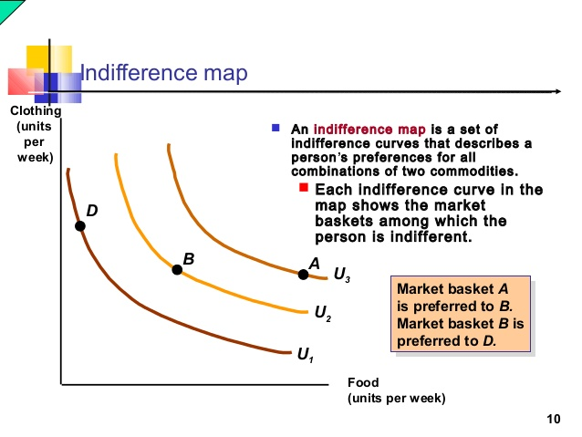
The Indifference Map is the graphical representation of two or more indifference curves showing the several combinations of different quantities of commodities, which consumer consumes, given his income and the market price of goods and services

Slide 51
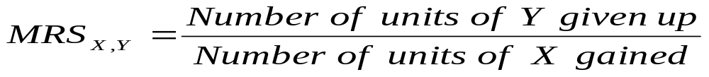
The Marginal rate of substitution (MRS)
Marginal rate of substitution of X for Y is defined as the rate at which a consumer is
willing to trade x for y.
It is the slope of an indifference curve, MRS = Δy/Δx.
the MRS varies along an indifference curve, that is, the MRS is in general different when the starting bundle of a potential trade changes

Slide 52
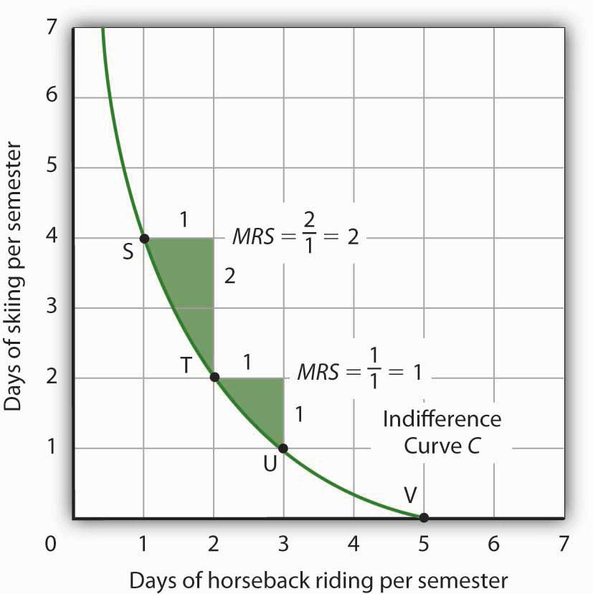

Slide 53
The Marginal rate of substitution (MRS)
For perfect substitutes, the MRS is constant.
Note that the marginal rate of substitution (MRS) of consumer Z depends on individual preferences as expressed by the indifference curves.
It does not depend on the market or the prices that may prevail in the market.

Slide 54
The Marginal rate of substitution (MRS)
An additional unit of good X increases the level of satisfaction of a consumer by the marginal utility of X, MUx.
Similarly, an additional unit of Y increases the level of satisfaction of a consumer by the marginal utility of Y, MUy.
The marginal rate of substitution is equal to the ratio of the marginal utilities,
MRSxy = Δy/Δx = - MUx/MUy

Slide 55
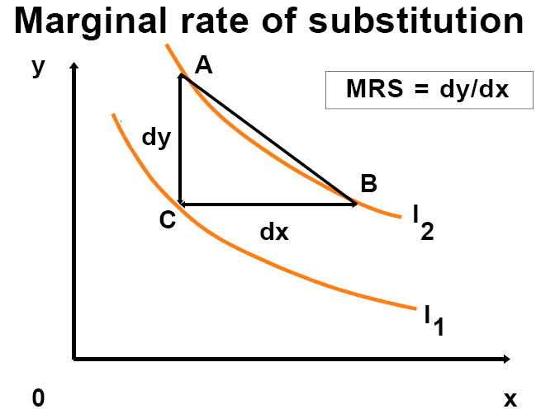
MOVE CHANGE IN UTILITY
A to C (MUy)(Δy)
C to B (MUx)(Δx)
MOVE CHANGE IN UTILIT
A to C (MUy)(Δy)
C to B (MUx)(Δx)
___________________________________
TOTAL, A to B
(MUx)(Δx) + (MUy)(Δy) = 0

Slide 56
The Marginal rate of substitution (MRS)
Total change in utility between A and B is zero because A and B are on the same indifference curve.
Rearranging the terms in this we derive the slope of the indifference curve,
(MUy)(Δy) = -(MUx)(Δx) MRS = Δy/Δx = - MUx/MUy

Slide 57
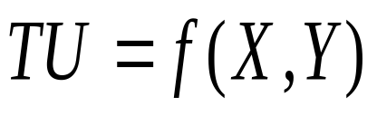
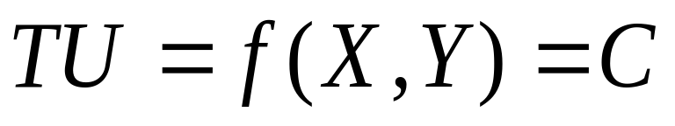
Proof:
Suppose the utility function for two commodities X and Y is defined as:
Since utility is constant on the same indifference curve:
,where C represents a constant number.
The Objective a rational consumer is maximizing Utility.
A function is optimal at its first derivative equals zero

Slide 58
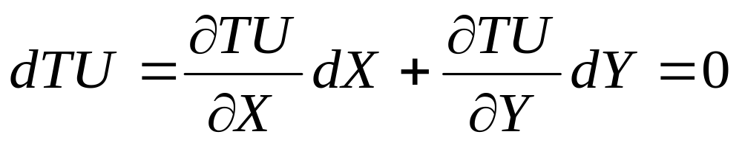
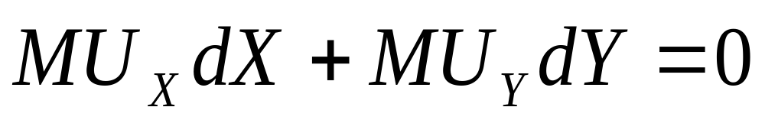
Proof:
. So we need to find the total derivation of TU function.
The total differential of the utility function is:

Slide 59
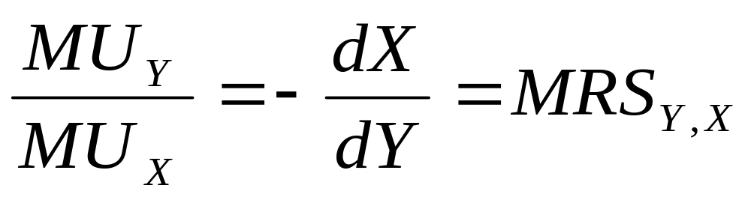
Proof:
or

Slide 60
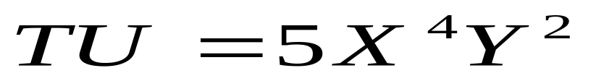
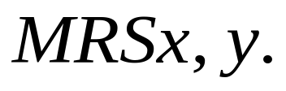
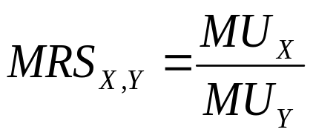
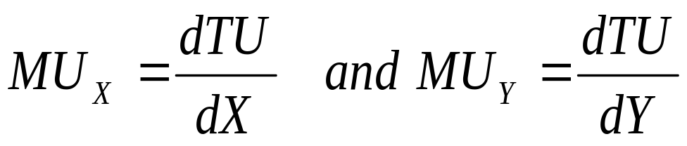
Example
Suppose a consumer’s utility function is given by
Compute the using the cardinal MU approach.
Where

Slide 61
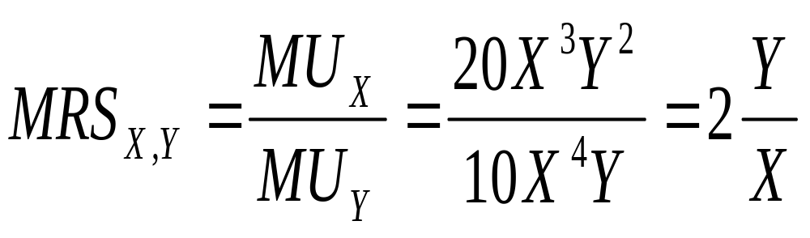
Example
Therefore
This means that the consumer is willing to substitute one Orange for two Bananas.

Slide 62
The Budget Line or the Price Line
Indifference curves only tell us about the consumer’s preferences for any two goods but they cannot tell us which combinations of the two goods will be chosen or bought (affordable).
in addition to consumer preferences, we need to know the consumer’s income and prices of the goods.
A consumer while maximizing utility is constrained by the amount of income and prices of goods that must be paid.

Slide 63
The Budget Line or the Price Line
This constraint is often presented with the help of the budget line constructing by alternative purchase possibilities of two goods.
The budget line is a line or graph indicating different combinations of two goods that a consumer can buy with a given income at a given prices.

Slide 64
Assumptions for the use of the budget line
there are only two goods, X and Y, bought in quantities X and Y;
each consumer is confronted with market determined prices, Px and Py, of good X and good Y respectivley; and
the consumer has a known and fixed money income (M).
By assuming that the consumer spends all his/her income on two goods (X and Y), we can express the budget constraint as:

Slide 65
Assumptions for the use of the budget line
Where, P_{X}=price of good X
P_{Y}=price of good Y
X=quantity of good X
Y=quantity of good Y
M=consumer’s money income
This means that the amount of money spent on X plus the amount spent on Y equals the consumer’s money income.

Slide 66
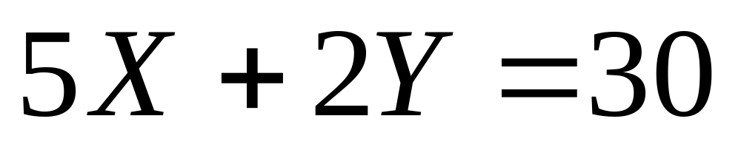
Example:
Suppose for a household with 30 Birr per week to spend on Orange (X) at 5 Birr each and Banana (Y) at 2Birr each. That is,
Therefore, our budget line equation will be:

Slide 67
Example:
Mathematically it is the y-intercept (0, 15).
Mathematically; it is the x-intercept (6, 0).
We may present the income constraint graphically by the budget line whose equation is derived from the budget equation.

Slide 68

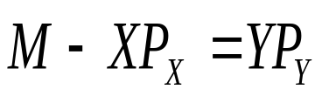
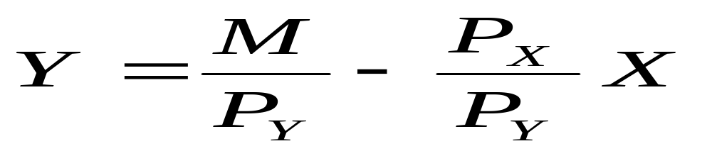
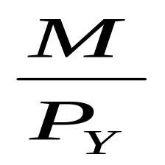
Example:
Solving for YP_{Y} we get . By rearranging the above equation we can derive the general equation of a budget line which is.
Where,
Vertical Intercept (Y-intercept), when
X=0 and

Slide 69
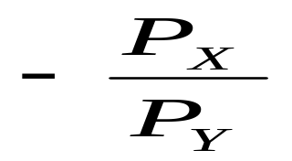
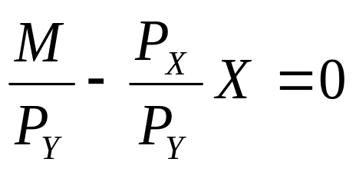
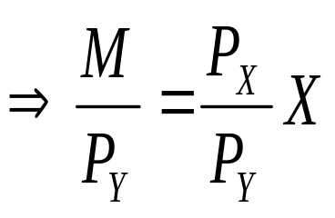
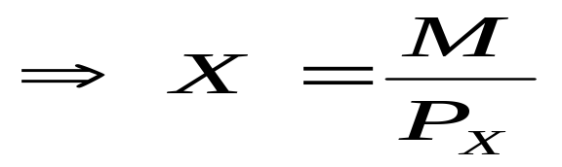
Example:
=
slope of the budget line (the ratio of the prices of the two goods)
The horizontal intercept (i.e., the maximum amount of X the individual can consume or purchase given his income) is given by

Slide 70
Factors Affecting the Budget Line
Effects of changes in income
If the income of the consumer changes (keeping the prices of the commodities unchanged) the budget line also shifts (changes).
Increase in income causes an upward shift of the budget line that allows the consumer to buy more goods and services and
decreases in income causes a downward shift of the budget line that leads the consumer to buy less quantity of the two goods

Slide 71
Thanks!!!!

